Slide 1
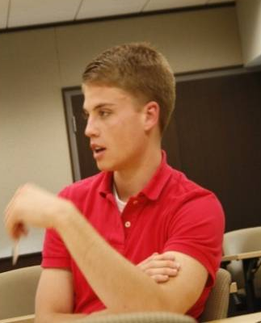
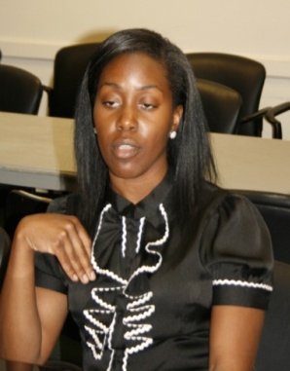
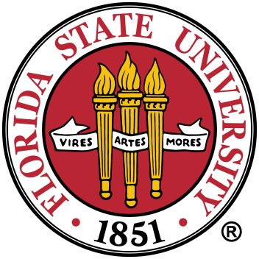
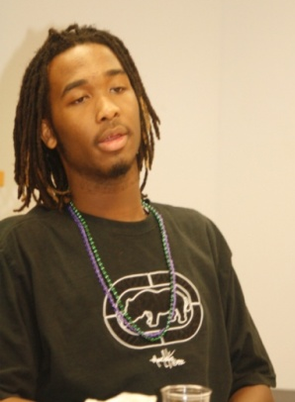
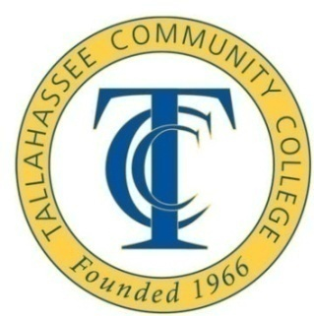
Final, condensed report RESEARCH FINDINGS AND RECOMMENDATIONS
Growing
Tallahassee’s
College
Educated
Workforce

Slide 2
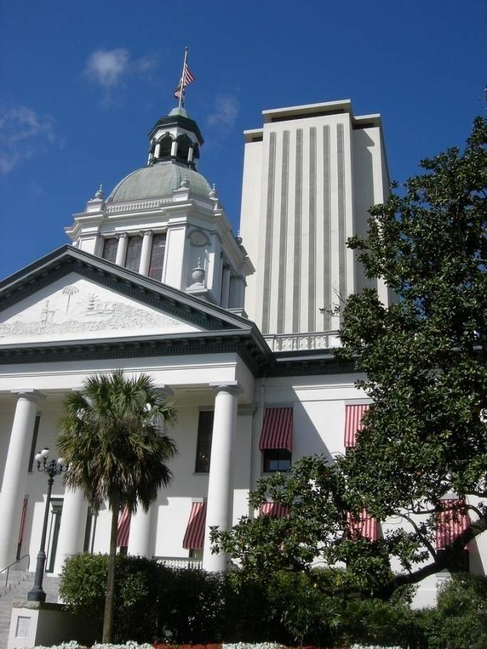
INCLUDED IN THIS PRESENTATION
Select Goals of this Project:
Identify a baseline college graduate retention figure for the Tallahassee region.
Better understand why students choose to stay or leave upon graduation.
Integrate recommendations with existing community projects to leverage and enhance Tallahassee’s creative economy.
TALLAHASSEE

Slide 3
BOILING IT ALL DOWN
Current students and recent grads agree that Tallahassee is a great place to go to college or to raise a family.
⬇
But the high college town rating is almost entirely based on their on-campus experiences and relationships.
⬇
Tallahassee – the city & state capital – has minimal impact on their initial college choice or eventual college career.
⬇
While enrolled, they do not develop a first-hand appreciation for Tallahassee’s social and professional offerings.
⬇
As a result, they do not perceive Tallahassee as having the quality of life amenities or career opportunities available elsewhere.
⬇
The result: They do not see Tallahassee as a good career choice.

Slide 4
OVERALL GRADUATE RETENTION RATE
100%
90%
80%
70%
60%
50%
40%
30%
20%
10%
0
73% leavers
27% Stayers
OVERALL
RETENTION :: BY SCHOOL
150
1039
228
82%
18%
FAMU
80%
20%
FSU
38%
62%
TCC
50
NATIVE
15%
11
8
NOW LIVING ELSEWHERE
STILL IN TALLAHASSEE
INITIALLY NATIVE

Slide 5
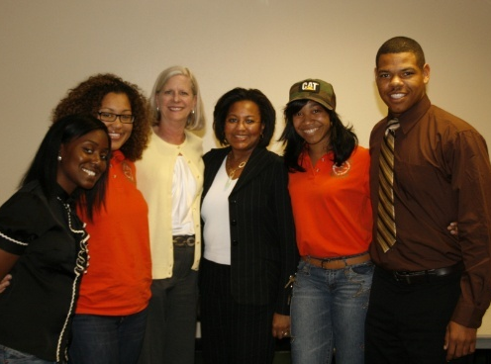
2004-06 TALLAHASSEE GRADS :: WHERE ARE THEY NOW
100%
90%
80%
70%
60%
50%
40%
30%
20%
10%
0
31%
42%
27%
OVERALL
 | Most Popular - elsewhere
 | Atlanta, Washington D.C. Charlotte, New York City
LEFT FLORIDA
 | Top FL. Destinations
 | Tampa Bay | 21%
 | Miami / South FL. | 20%
 | Orlando | 18%
 | Jacksonville | 14%
 | W. Palm Beach | 9%
ELSEWHERE IN FLORIDA
BASED ON 980 RESPONSES
STILL IN TALLAHASSEE

Slide 6
WHAT THOSE WHO STAYED IN TALLAHASSEE ARE DOING NOW
Characteristics of those employed full-time in Tallahassee:
42% have a Master’s degree or higher
53% interned locally while in college
62% are not originally from here
31%
42%
27%
OVERALL
 | Top Industries
 | 1. | Government | 24%
 | 2. | Education | 23%
 | 3. | Prof. Services | 14%
 | 4. | Non-profits | 10%
 | 5. | Fin. Services | 8%
 | 6. | Health care | 7%
 | 7. | IT | 5%
 | Current Status
 | 1. | Employed FT | 69%
 | 2. | Enrolled FT | 15%
 | 3. | Employed PT | 8%
 | 4. | Unemployed | 5%
STILL IN TALLAHASSEE
BASED ON 390 RESPONSES

Slide 7
OVERALL GRADUATE RETENTION RATES …INFLUENCE OF INTERNSHIPS
100%
90%
80%
70%
60%
50%
40%
30%
20%
10%
0
73%
27%
OVERALL
IMPACT of INTERNSHIPS
426
202
99
690
62%
38%
Interned Locally
91%
9%
Interned Elsewhere
85%
15%
Here + Elsewhere
73%
27%
Didn’t Intern
NOW LIVING ELSEWHERE
STILL IN TALLAHASSEE

Slide 8
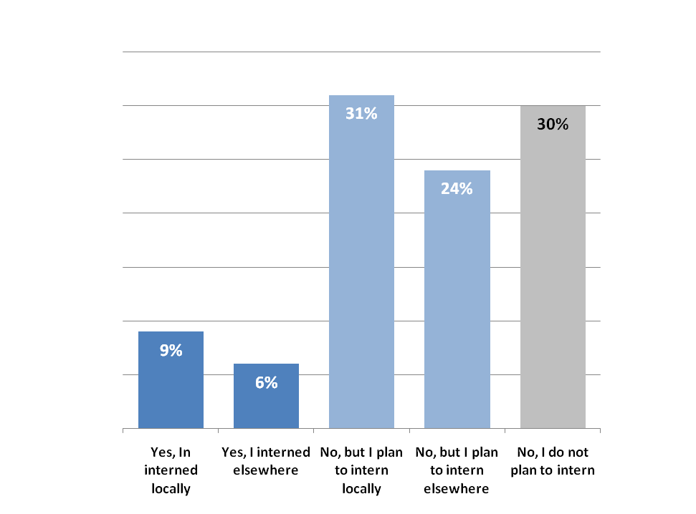
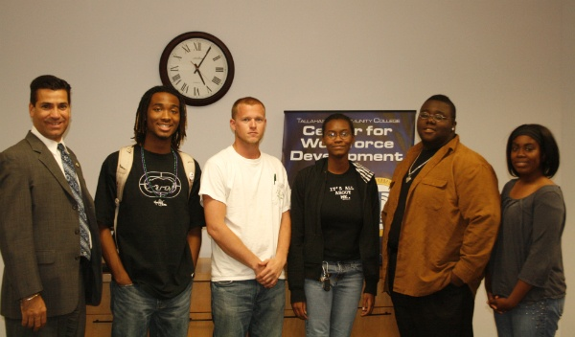
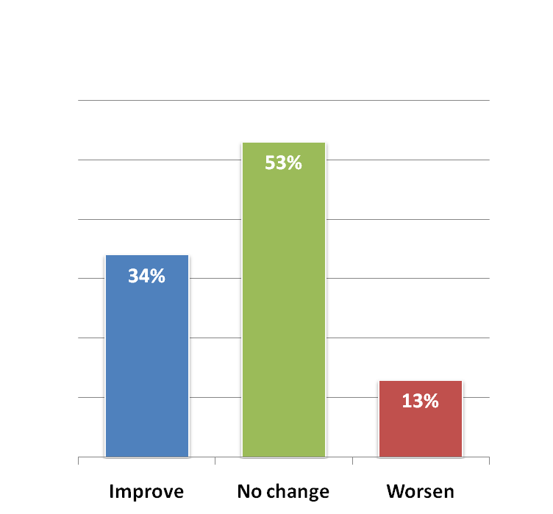
ENROLLED STUDENT SURVEY :: THE IMPACT OF INTERNSHIPS
… but only 40% of the students polled have or plan to do a local internship.
Interning locally does improve perceptions …

Slide 9
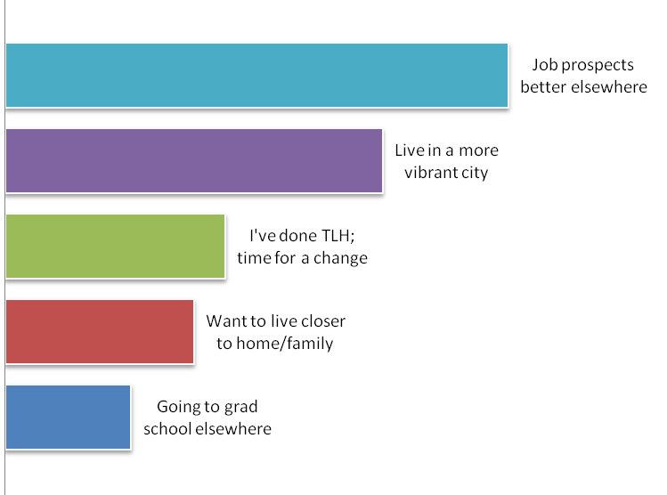
CURRENT STUDENTS :: FUTURE PLANS
ENROLLED STUDENTS
51% plan to leave
27% undecided
22% plan to stay
weighted
32%
24%
14%
12%
KEY REASONS FOR LEAVING TALLAHASSEE
8%

Slide 10
TOP TAKEAWAYS FROM ENROLLED STUDENTS
Great place for college, but … -- It’s where you “get your degree and go.” -- Stigma associated with staying in Tallahassee. -- Very family-oriented, so “not for me.” -- “FSU just happens to be in Tallahassee.” -- Students have much more positive perceptions of Atlanta, Miami, and Orlando.
Interested in doing more off-campus, but … -- Don’t know where to go or what to do. -- Very low perceptions of shopping options. -- No established means of getting local info. -- Little association with Tallahassee as a capital city.
Feel little connection to area -- Not a major factor in decision to enroll -- State capital has little perceived value -- No strong connection to downtown -- “We don’t stick around because we don’t know Tallahassee.” -- Believe Tallahassee is probably better than it appears, but there’s currently little evidence.

Slide 11
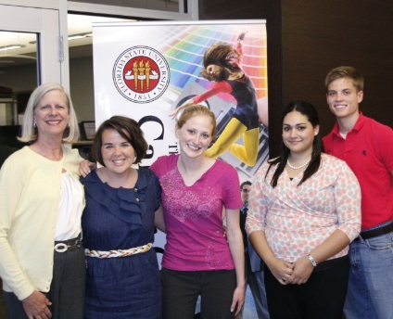
(cont.) TOP TAKEAWAYS
Largely unaware of local career opportunities
-- Business community has no presence on campus. -- Very little interaction with local employers. -- “We don’t stick around because we don’t know. -- Big interest in networking with community leaders -- “Access to capital should be incredible, but isn’t.” -- Strong sense opportunities are better elsewhere.
“Word of mouth” stands alone -- 80% learn what’s happening from friends -- No clear resource for local information or events -- If students knew more they would do more -- Word of mouth, Web, and flyers are key -- Network of on-campus connectors a must
Other -- “Black FAMU and black FSU don’t mix.” -- High cost of air travel is an issue for some. -- Only FSU wants more inter-campus activities -- “It’s a benefit to have a capital here, but we don’t capitalize on it.”

Slide 12
BRINGING IT ALL TOGETHER
Students
Colleges
Employers
Government
Community
WORK TOGETHER TO ELEVATE PERCEPTIONS OF TALLAHASSEE AS A GREAT PLACE TO LAUNCH YOUR CAREER.

Slide 13
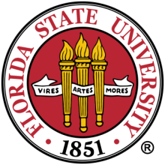
TALLAHASSEE STUDENT ENGAGEMENT PROJECT :: SUGGESTED STRATEGIES
1.
Improve student perceptions of Tallahassee as much more than a college town … a great place to launch your career.
Build communications bridge
Provide students with immediate, easy access to information on Tallahassee.
Recruit student ambassadors
Work with a team of students on each
Campus who will spread the word.
Enlist the community
Encourage local leaders & organizations
to involve students in their own efforts.
Raise Capital City awareness
Elevate awareness of capital city status
and how to take full advantage of it.
Talk up the local economy
Increase student awareness of key local employers & cool career opportunities
2.
3.
4.
5.

Slide 14
TALLAHASSEE CORE MESSAGING ATTRIBUTES
Outdoor activities
Natural beauty
Active lifestyle Not materialistic-----
Lake Ella / Tom Brown Park Fresh foods / farmers market Strong health & fitness focus
Passion for sports
Active
Downtown Get-down
Springtime Tallahassee
Southern hospitality
Tallahassee Welcome
Community living environments
Proximity to ATL, JAX, Orlando
[shopping]
University town personae
Tallahassee Film Festival
Open-minded YP organizations
Multicultural history
The New South
Railroad Square [Gaines Street]
Friendly Youthful College town Scholarly
Outdoorsy
Pretty
Fun
Friendly
Progressive
TLH
Florida’s Capital City
Unversity R&D activity Innovation Park / Summit East Key industry clusters
FSU Magnet Lab Challenger Center
Smart
Capital City
Power Center
Internships
Mini D.C.
Make your mark For community … YP orgs
TALLAHASSEE IS AN IDEAL PLACE TO LAUNCH MY CAREER.

Slide 15
RECOMMENDED NAME FOR PROGRAM AND WEB SITE
Friendly
Smart
Capital City
Progressive
Active

Slide 16
CONNECTING WITH OTHER RELATED EFFORTS
Related Efforts
Network of Young Professionals
VolunteerLEON
College Leadership Tallahassee
Access Tallahassee
Sustainable Tallahassee
KCCI
Workforce Plus
Related Local Links Provide by Barbara Boone
Tallahassee.com
Wayfm.com
Morethanyouthought.com
Everythingtally.com
VisitTallahassee.com
Hellotallahassee.com
Reinvestlocal.com
FSUnews.com
Tallymarket.com
Wtwc40.com
Talchamber.com
Networkyp.com
Mrtlh.com/events
Volunteerleon.org
Wfsu.org
Unitedpartnersforhuman services.org
Bigbendhealth.com
Wfplus.org

Slide 17
REGIONAL HIGHER-ED CENTRIC COLLABORATIONS
WHO BENEFITS
ACADEMIA
TOURISM
ECONOMIC DEVELOPMENT
CIVIC/REGION
BUSINESS
PHILANTHROPY
enrollment, retention, faculty ++
visitor & student spending
grad retention, new companies/jobs
perceptions, attitudes, revenue
new hires, interns, revenue
workforce dev., edu. attainment

